Slide 1
Lecture 14: Data Repairing

Slide 2
Today’s Agenda
Recap and Data Repairing
Constraint-based Data Repairing
Probabilistic Data Repairing

Slide 3
1. Recap and Data Repairing
Section 1

Slide 4

What is a Data Error?
Section 1

Slide 5
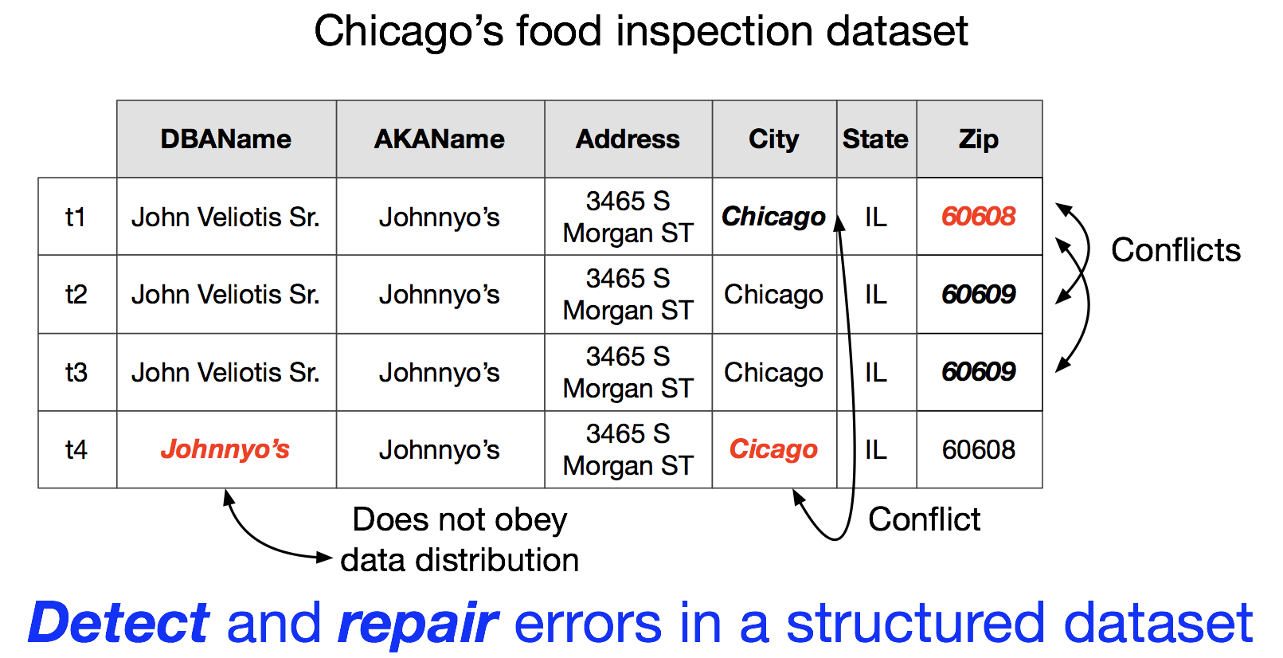
Example
Section 1

Slide 6
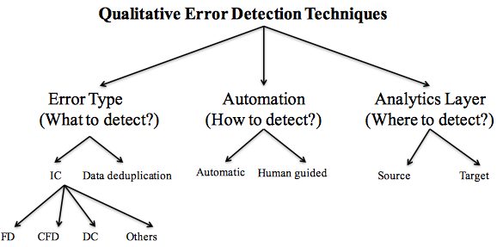
Error Detection Taxonomy
Section 1

Slide 7
Example
Section 1
No constraint violations but did we fix the errors?

Slide 8
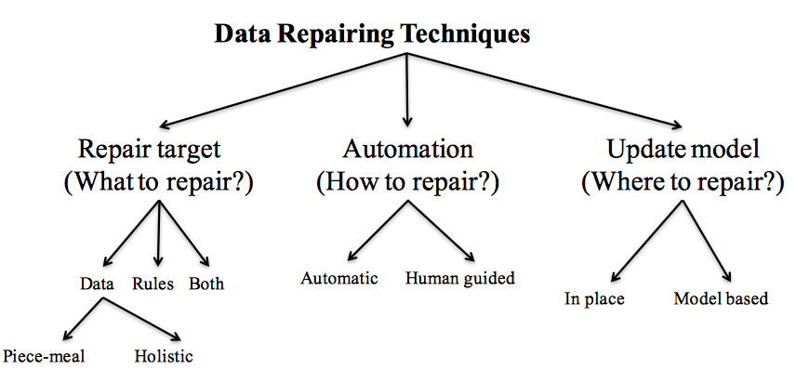
Data Repairing Taxonomy
Section 1

Slide 9
How to automate?
Section 1
Most automatic repairing techniques adopt the “minimality” of repairs principle
Repairing techniques in practice are manual and semi-automatic at best

Slide 10
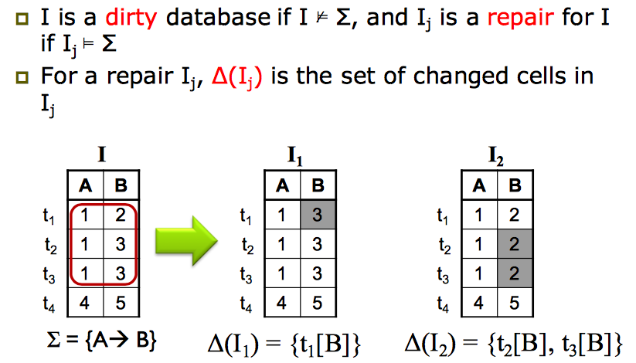
Data repairs by Value Update
Section 1

Slide 11
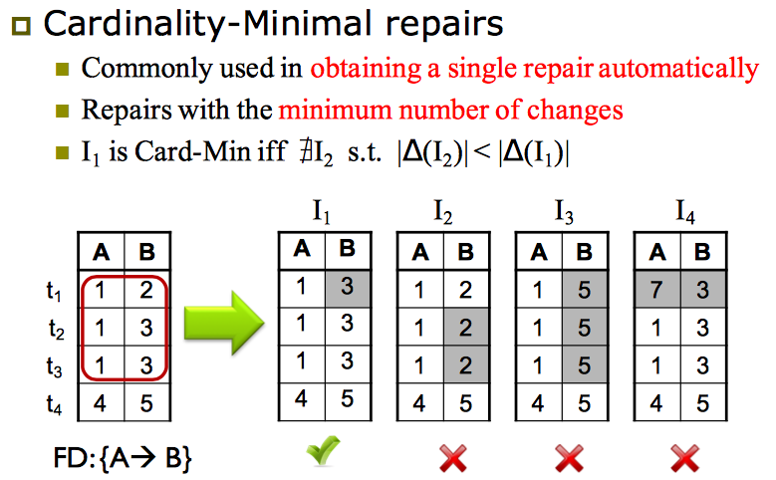
Data repairs by Value Updates
Section 1

Slide 12
2. Constraint-based Data Repairing
Section 2

Slide 13
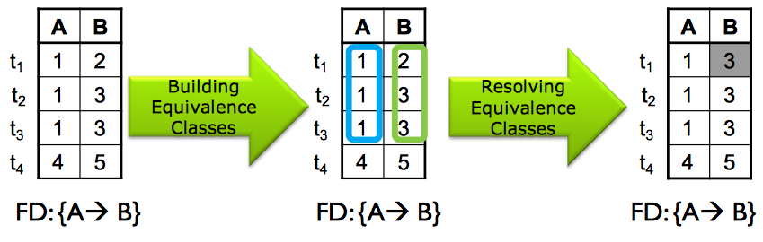
FD-based repairing
Section 2

Slide 14
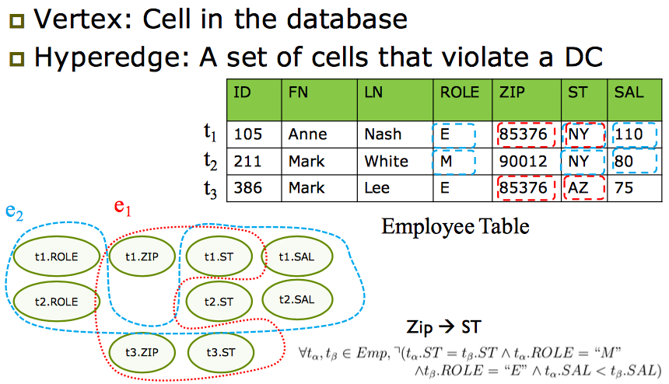
Holistic Constraint-based Repairing
Section 2

Slide 15
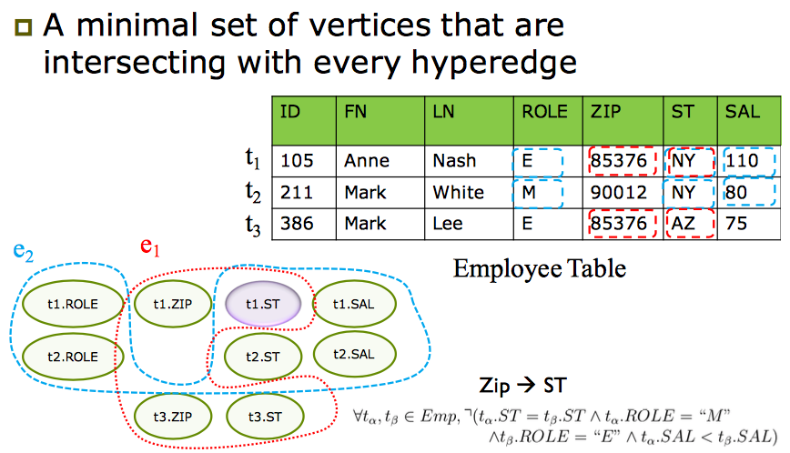
Step1: Minimal Vertex Cover
Section 2

Slide 16
Step2: Collect Repair Requirements
Section 2

Slide 17
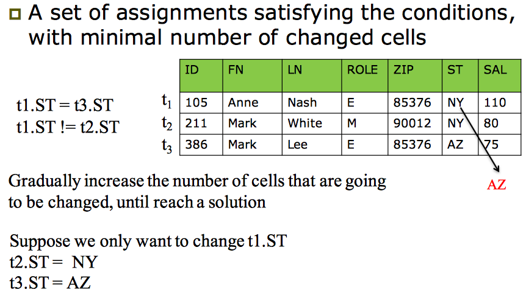
Step3: Get Updates
Section 2

Slide 18
Step3: Get Updates
Section 2

Slide 19
3. Probabilistic Data Repairing
Section 3

Slide 20
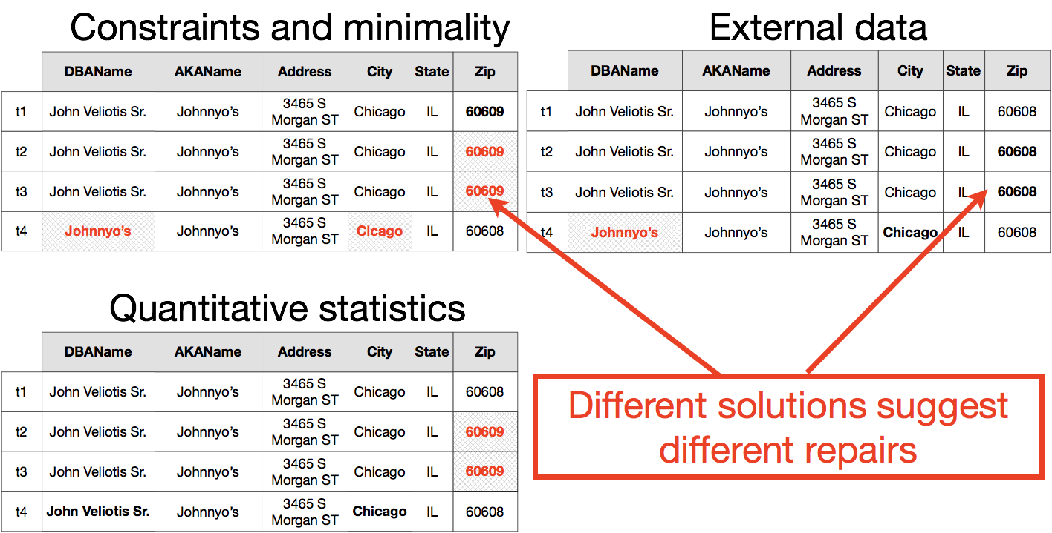
Lots of Possible Repairs
Section 3

Slide 21
Probabilistic Data Repairs
Section 3

Slide 22
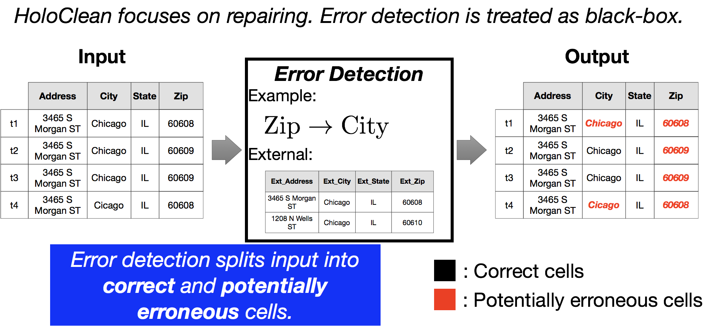
Error detection as a black box

Slide 23
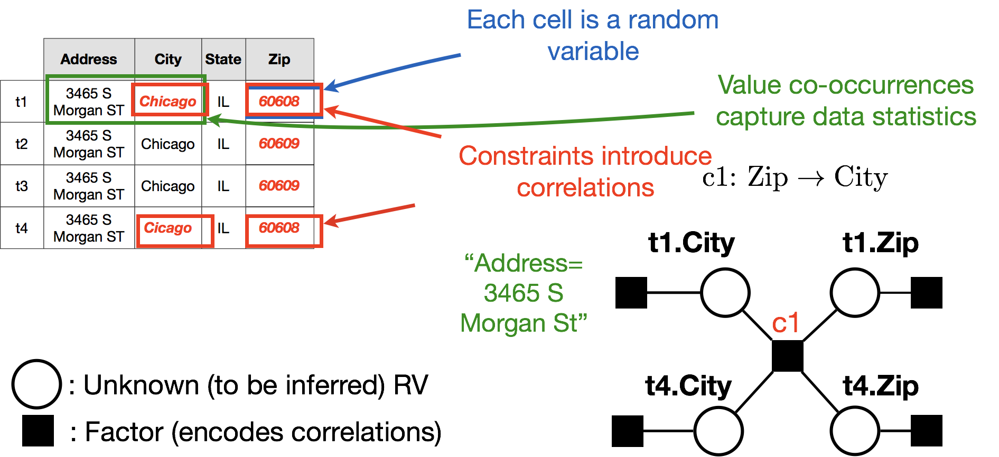
A model for data repairs

Slide 24
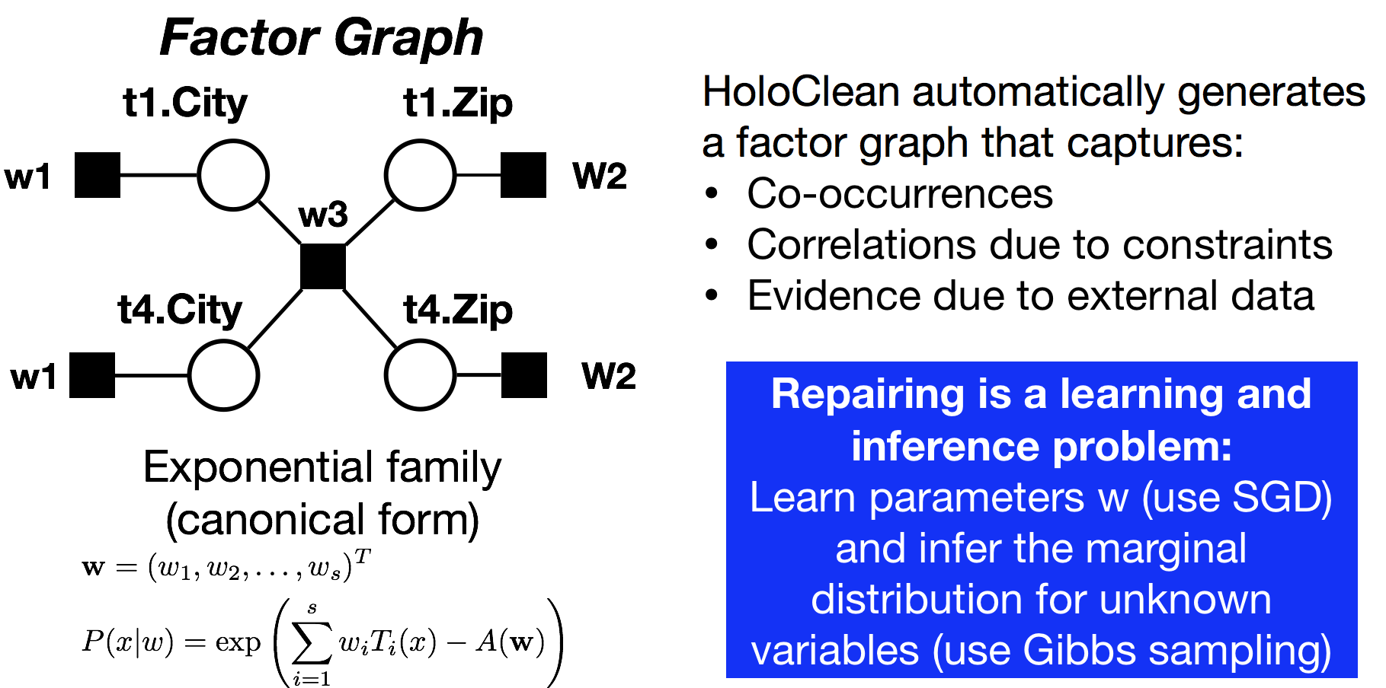
A model for data repairs

Slide 25
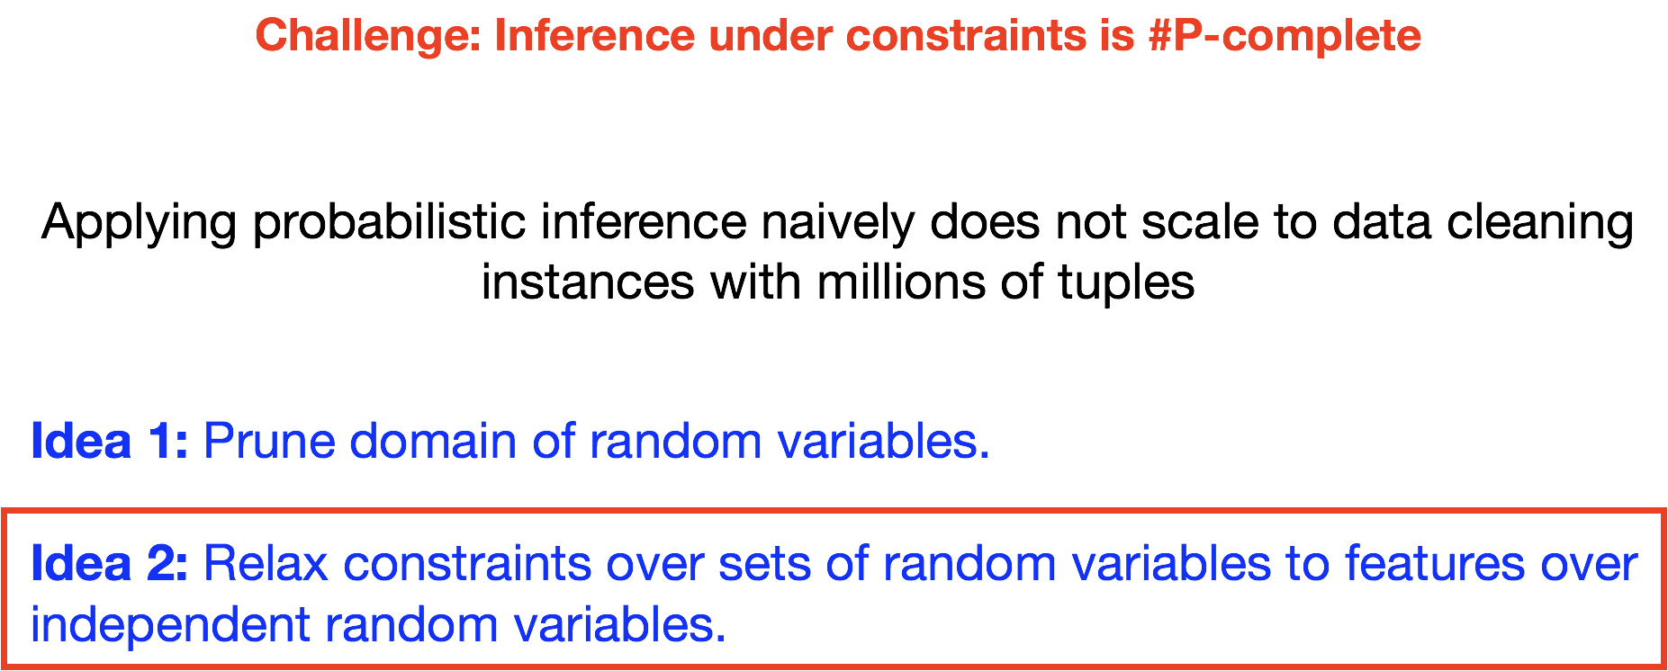
Scaling inference

Slide 26
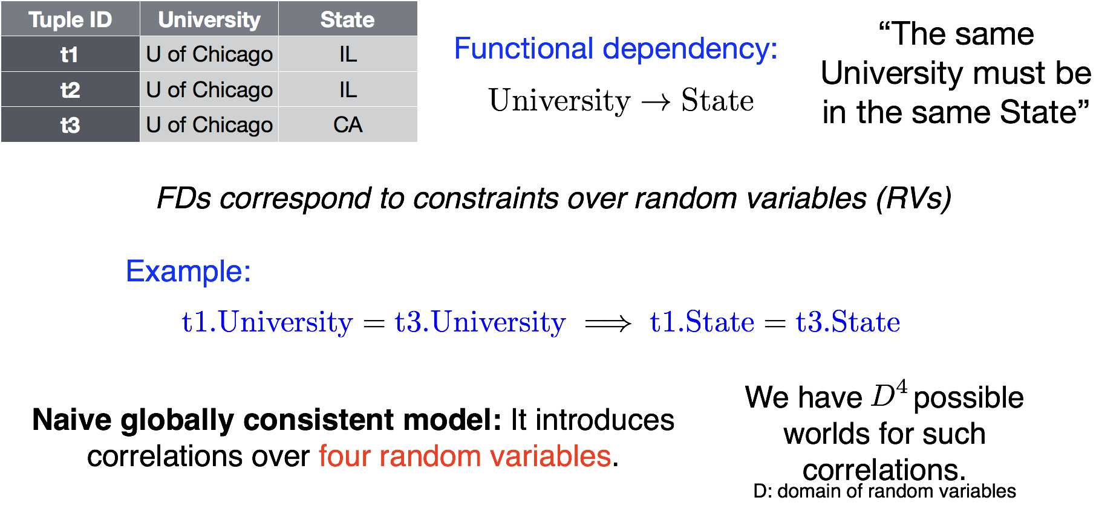
Relaxing Constraints

Slide 27
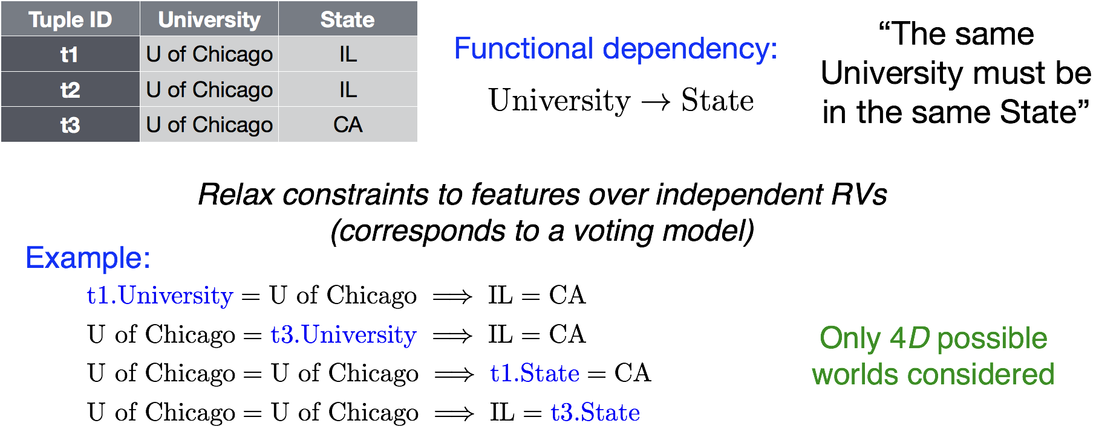
Relaxing Constraints

Slide 28
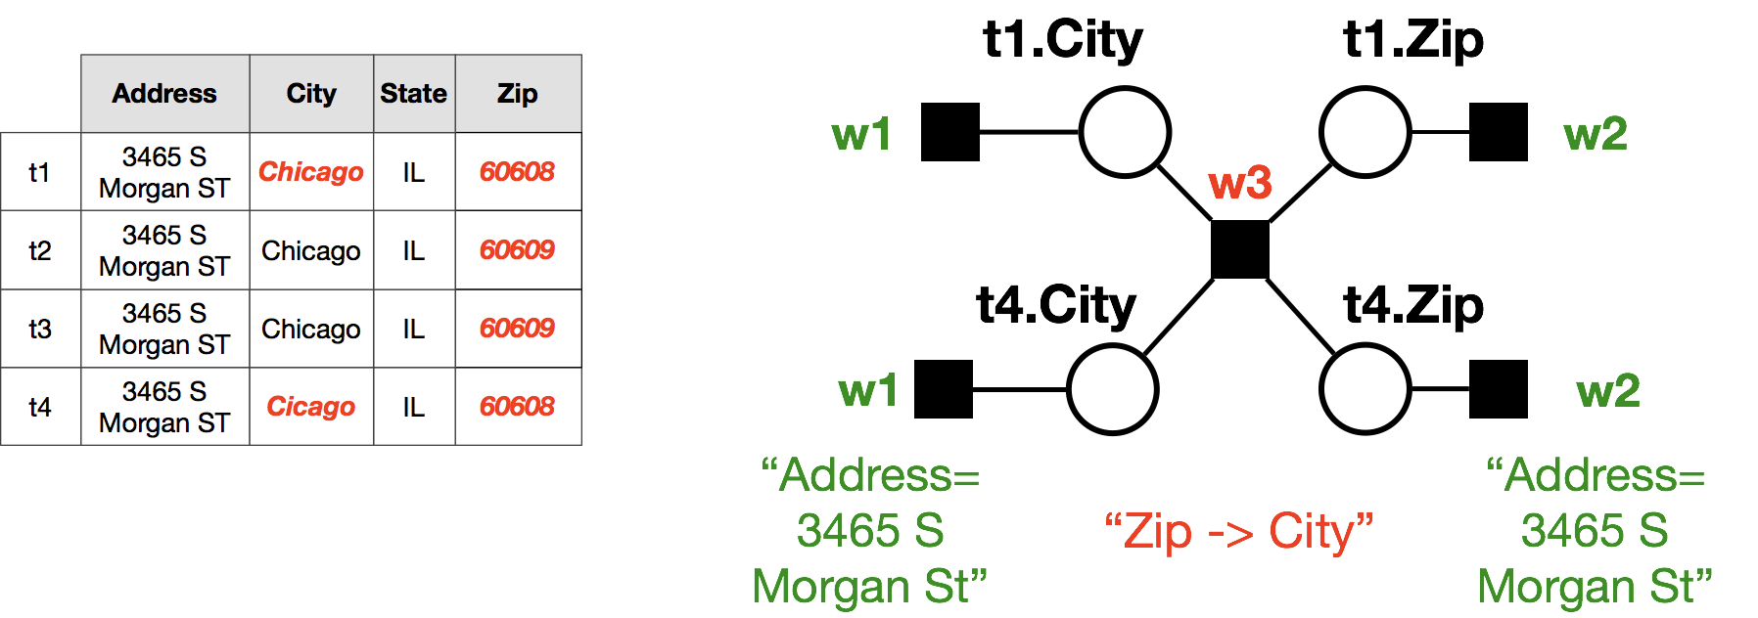
Relaxing Constraints

Slide 29
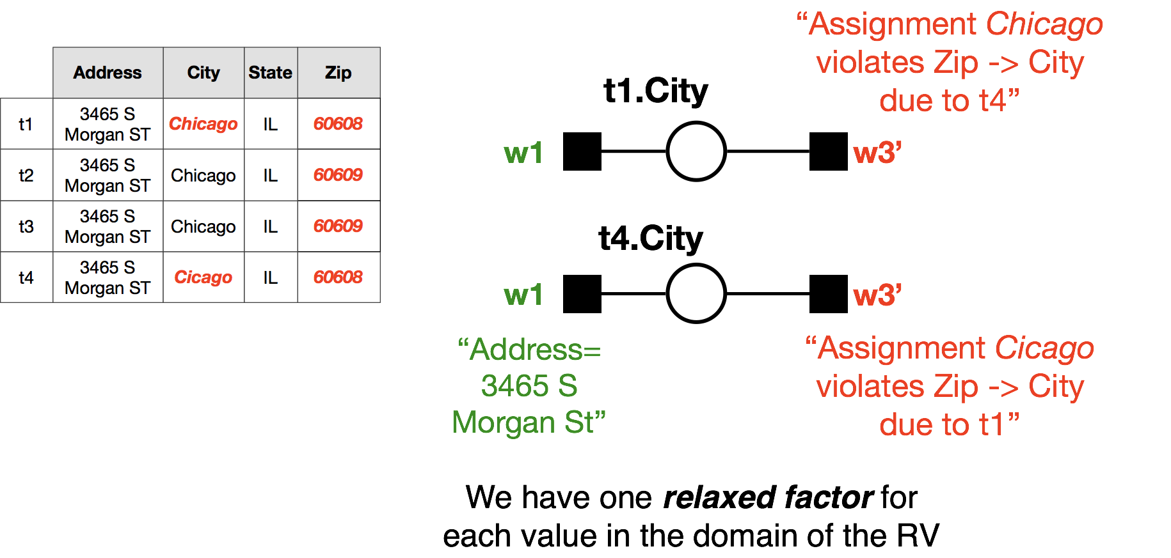
Relaxing Constraints

Slide 30

Relaxing Constraints

Slide 31
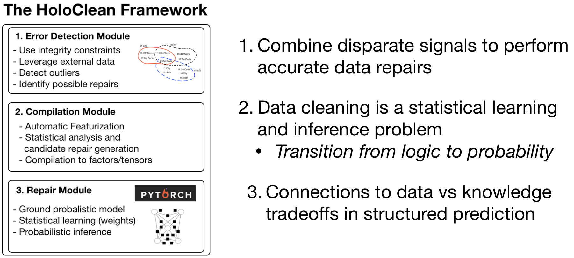
Data repairing as an ML problem
Section 3

